Slide 1
30 Mins of Innovation : Indirect X
Markus Gilg & Ajit Gautam
08 January 2025

Slide 2
Procure-2-Receipt (P2R) Indirect Indirect X | Objectives
(Gen) AI capabilities Decision guidance for requesters and approvers
Automation
High E2E automation of Procure2Receipt process
Aspiration:
Indirect X is a leaner, less complex and more user-friendly solution
Integration
myMall & Indirect X seamlessly integrated
SHERPA X
Indirect X is embedded in SX ecosystem
Usability
Modern UI consistent from Procure2Receipt for improved UX
Reduced Complexity
Aligned complexity reduction compared to today’s processes

Slide 3
Indirect X : Our Incremental North Star journey
DEEP DIVE in F2S-Workshop 29.11., 9.00am – 12.00pm CET
Phase 1
Pilot GoLive “Buzias”
Phase 2a
ARE Migration and
Onboarding
Phase 2b
Increments FY25
Phase 3
ARE Onboarding &
Regular Releases
FY2025
10/2024
(Release 1320)
FY2025
Q2-Q4
FY2025
Q2-Q4
As of
FY2026ff

Slide 4
Procure-2-Receipt (P2R) Indirect Pilot GoLive „Buzias“ : New Global Solution “Indirect X”
Workflow Steps
myMall
SAP (S4/BTP)
SCM Star

Slide 5
Indirect X Process Steps
myMall
Create Requirement (SC)
BTP
Complete Requirement (PR)
Approve the PR/PO
S4 HANA
Manage PR
Manage PO
Send PO to Supplier (Automatic)
Post Goods Receipt
Automatic e-mail notification trigger
Reverse the GR

Slide 6


Slide 7
Q&A

Slide 8
Back Up Slide

Slide 9

Procure-2-Receipt (P2R) | Indirect Simplified Architecture overview
SAP S4
AIF (myMall)
FLP
PR / PO / GR (System of records)
myMall
Catalogs
Shopping Cart
PR creation
SAT
Approver data
Get SAT GIDs
PR, PO, GR feedback
PR / PO events
Various APIs*
SAP BTP
PA forms**
FLP
Apps (PO Change)
SCM STAR
RFQ processing
Initiate RFQ
Get RFQ results
*) PR change, PR release, PO creation, PO change, PO release, Asset creation, GET calls for supplier, value helps, user data, etc.
**) Requester completion, Supplier selection, Purchaser, Asset Expert, Func/Comm approver, Support

Slide 10
OCI Punchout Process
S4
myMall
S4
Go to Fiori App F2229- Manage Purchase Requisition Professional.
Create PR by selecting item from external catalog
Choose the items from available catalog items.
Catalog item details will be transferred to S4.
Finalize shopping basket
Adding multiple lines are possible.
Complete the PR.

Slide 11
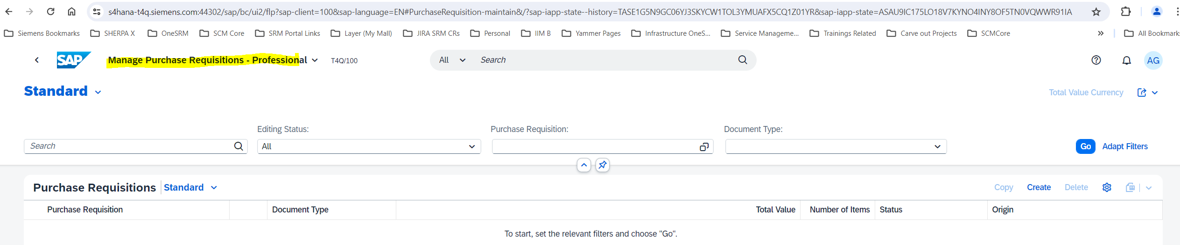
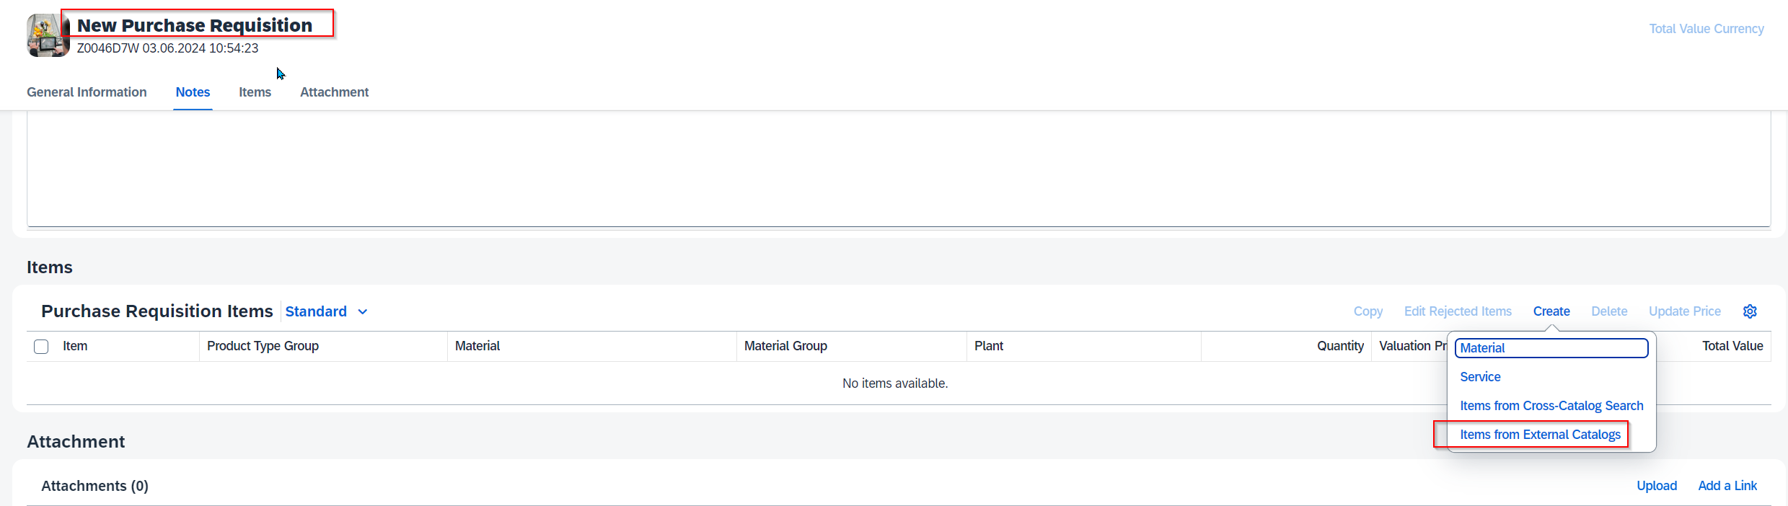
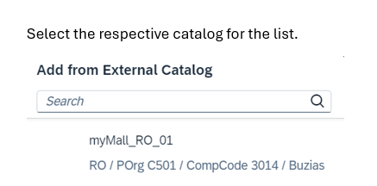
Process Steps
11
2
3
5
4

Slide 12
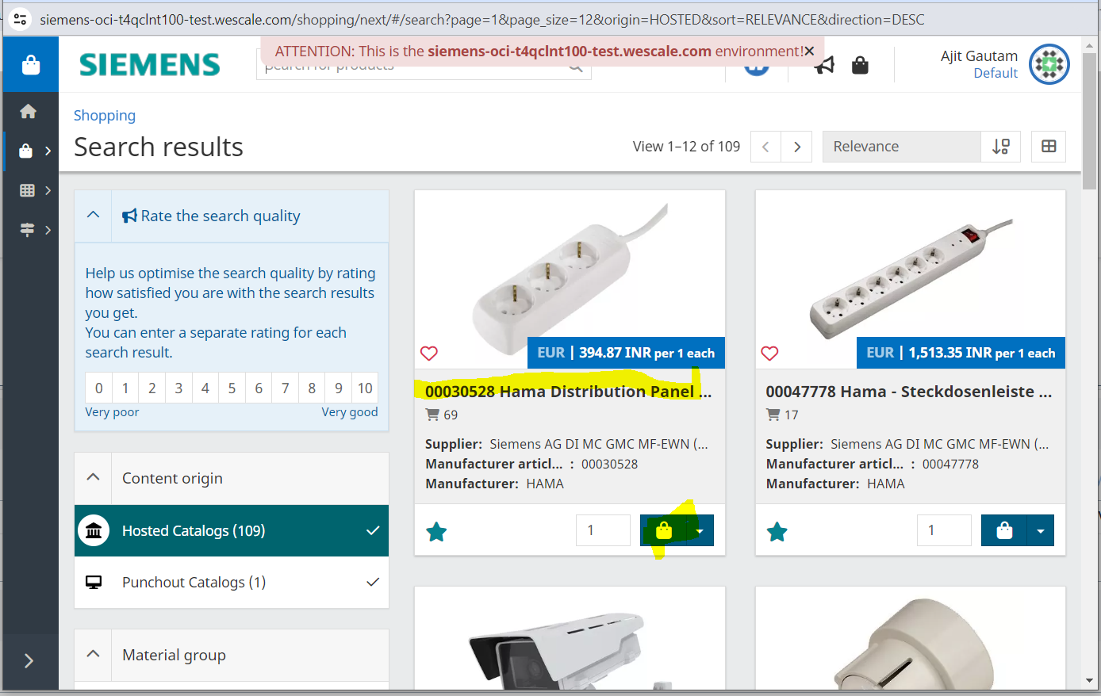
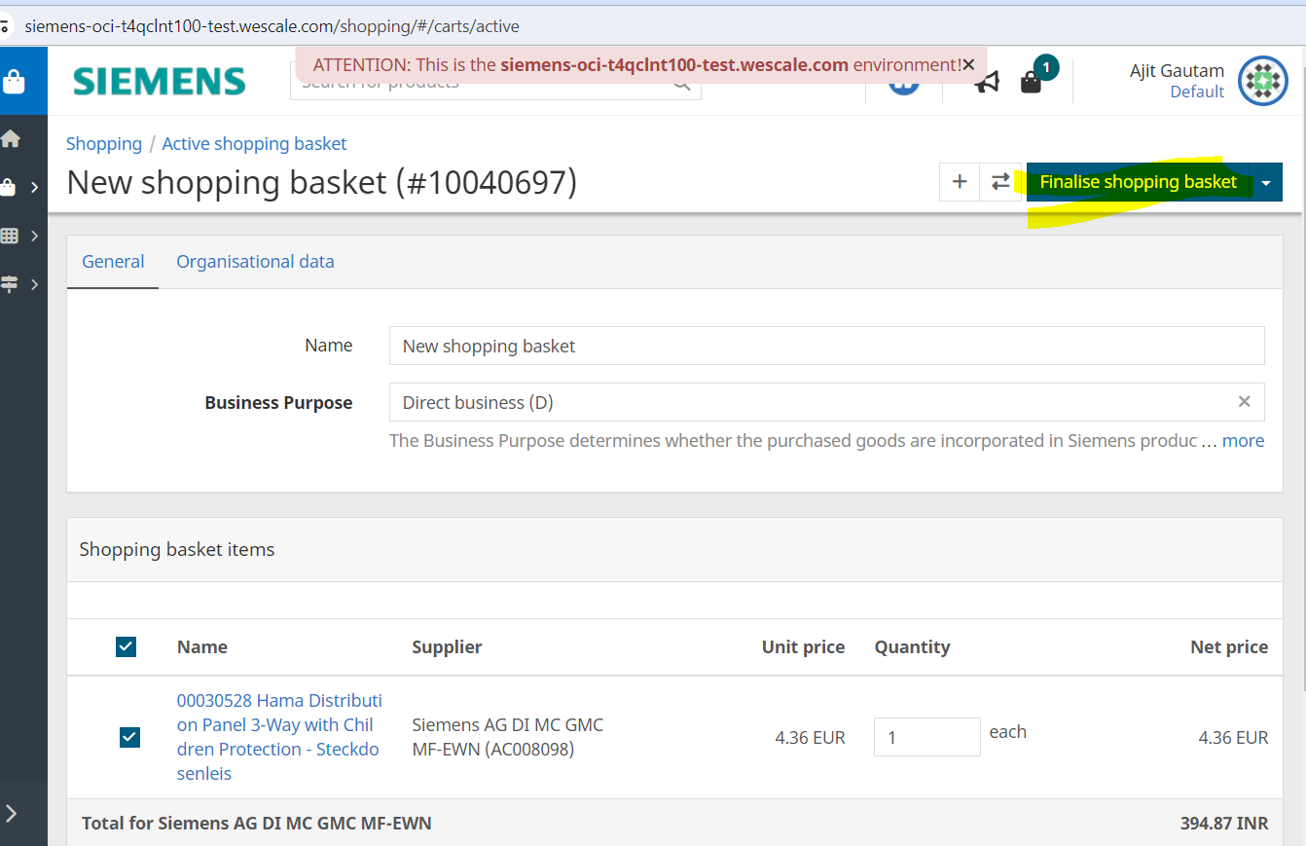

Slide 13

Procure-2-Receipt (P2R) | Indirect PR/PO Release Strategy – Interaction between BTP-PA and S4
Workflow Step 1 (Purchaser)
Workflow Step 2 (Expert 1)
Workflow Step 3 (Expert 2)
Workflow Step N (Commercial Approver)
Control and execution of individual workflows per unit
Submit PR/PO for processing, document result and follow-up (e.g. printout)
BTP-PA
…
1-step Release Strategy for technical purpose only
SAP S4
Use full flexibility of BTP-PA to define any kind of workflows based on S4 documents PR and PO
S4 is customized within SAP standard and only start and end of workflow represented in Release Strategy
Users will not be impacted by that because release is controlled from BTP-PA in background
Page 13

Slide 14
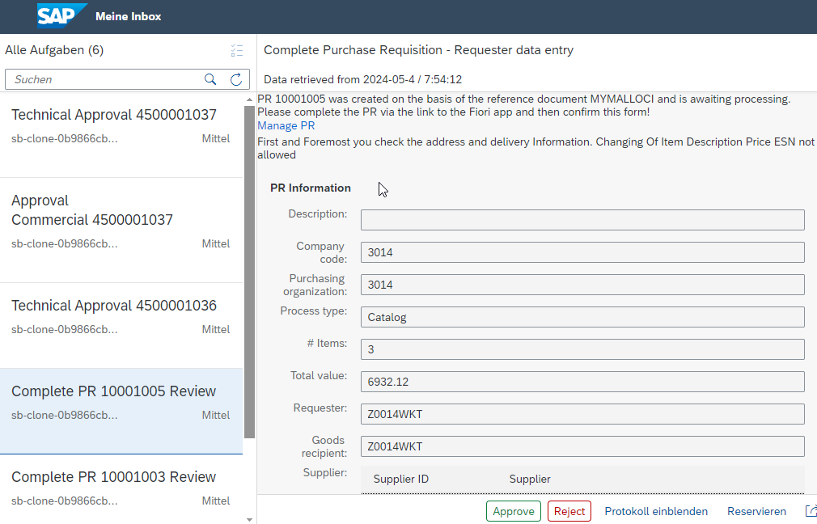
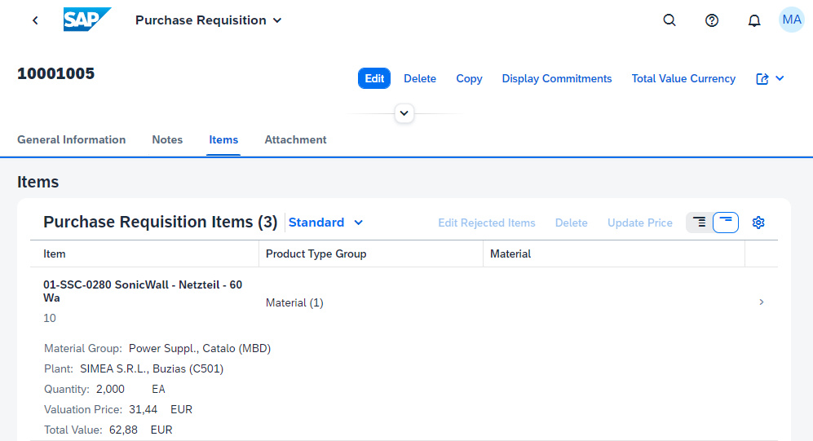
Procure-2-Receipt (P2R) | Indirect Interaction BTP-PA Workflow step and S4 Fiori app usage
Check BTP-PA form and jump to S4 Fiori app
Update document in S4 fiori app
Approve / Reject BTP-PA form
1
2
3
Page 14

